Slide 1

School of School of Computer Engineering & Technology
Presentation for TY Mini Project (Final Presentation)
Sentiment Analysis of IMdb Ratings of Movies
Students Name:
Jayshri Sable (055)
Srushti Naikare (073)
Manish Shingare (215)
Guide:
Mrs. Neha Hajare

Slide 2
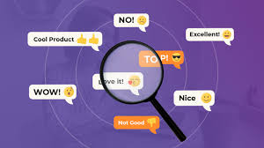
Index
Introduction
Problem Statement and Objectives
Literature survey
Block Diagram and it explanation
Methodology
Complete Implementation
Result
References

Slide 3


Introduction
Sentiment Analysis
Sentiment analysis is a natural language processing technique used to determine whether data is positive, negative or neutral.
It determines whether a piece of writing is positive, negative or neutral
Sentiment analysis is often performed on textual data to help businesses monitor brand and product sentiment in customer feedback, and understand customer needs.

Slide 4

Why Is Sentiment Analysis is Important ?
Sentiment analysis is extremely important because it helps businesses quickly understand the overall opinions of their customers. By automatically sorting the sentiment behind reviews, social media conversations, and more, you can make faster and more accurate decisions.
The overall benefits of sentiment analysis include:
Sorting Data at Scale
Real-Time Analysis
Consistent criteria

Slide 5
Problem statement
To perform Sentiment Analysis on IMdb reviews of Movies by lexicon approach and to identify whether review is positive, negative or neutral.
Objectives to be achieved
1. To implement an algorithm for automatically classification of text into positive, negative and neutral.
2. To study and implement tokenization.
3. To study and implement lemmatization.
4. To calculate polarity value of review.
5. To calculate accuracy of the algorithm

Slide 6
Literature
Survey
Author Name | Paper title | Date | Publishers | Conclusion
Walaa Medhata | Sentiment analysis algorithms and applications: A survey | 27 May 2014 | Ain Shams University. | The main target of this survey is to give nearly full image of SA techniques and the related fields with brief details.
Maite Taboada | Lexicon-Based Methods for Sentiment Analysis | 28 September 2010. | Simon Fraser University. | The main conclusion of our work is that lexicon-based methods for sentiment analysis are robust, result in good cross-domain performance, and can be easily enhanced with multiple sources of knowledge.

Slide 7
Karthik Konar | A Systematic Study on Sentimental Analysis and its Applications | 06 June 2020 | NMIMS Mukesh Patel School of Technology Management & Engineering, Vile Parle(West) Mumbai. | VADER Sentiment analysis approach to classify the accuracy of positive and negative reviews and the time taken for execution is very less when compared with the lexicon and machine learning approach.
Firoz Khan | Sentiment Analysis of Twitter Data | 30 July 2018 | Columbia University | They use previously proposed state-of-the-art unigram model as their baseline and report an overall gain of over 4% for two classification tasks: a binary, positive versus negative and a 3-way positive versus negative versus neutral.
Fazal Masud Kundi. | Lexicon-Based Sentiment Analysis in the Social Web. | 26 May 2014 | Gomal University. | In this paper we developed a framework for sentiment classification by integration of lexicons and dictionaries. The system needs to improve the precision in negative cases and recall in neutral cases

Slide 8
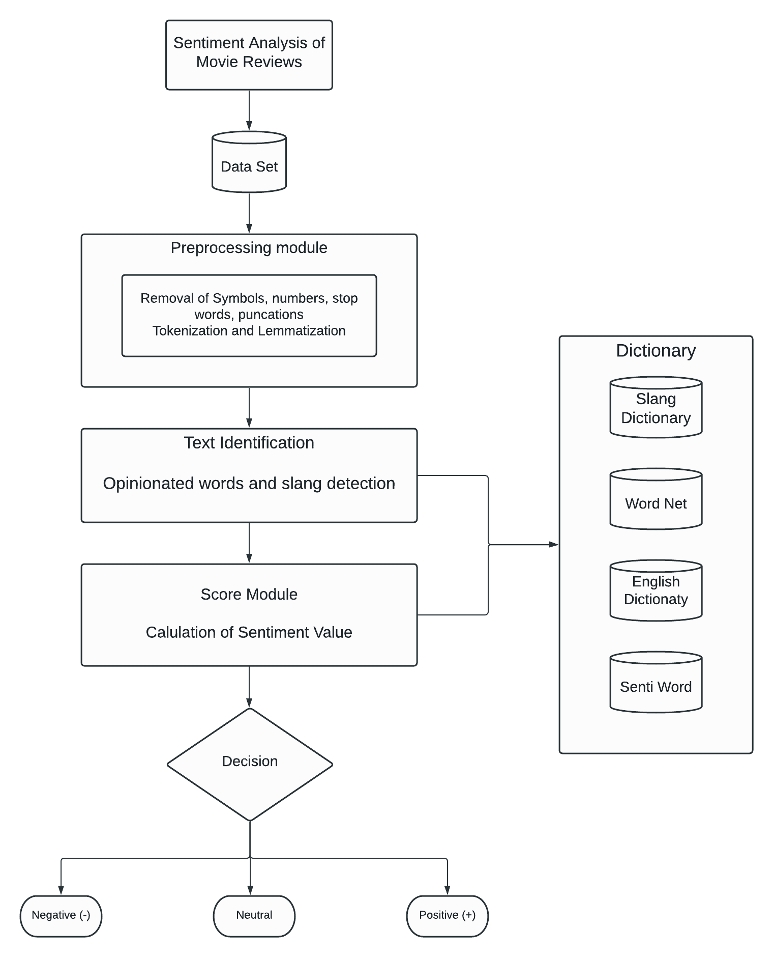
Proposed
Block System

Slide 9
1. Here the dataset is first imported from the database
2. Preprocessing steps are carried out on a dataset. It includes data cleaning, tokenization, lemmatization
3. It identifies the words based on adjectives, verb, adverb and classified with the help of dictionaries.
4. Then with the help of score module, calculate sentiment value
5. The review will be classified into positive, negative, neutral based on sentiment value

Slide 10
Methodology
The selected approach for our project is “Lexicon Based ”.
Where we will be using a Dictionary based approach. The dataset has reviews of movies. The problem statement is to predict whether the review is positive, negative or neutral.
It is referred to as a classification problem as we are identifying the sentiment of the review. Here we are using dictionaries which have set words classified sentiment wise and having score which would help us to calculate the sentiment value

Slide 11
Algorithm analysis :
Step 1: Importing the data set
Step 2: Removing single letters and numeric from the reviews
Step 3: Snippet to tag the parts of speech for each review
Step 4: Narrow down each review with only adjectives and verb forms
Step 5: Making a list of tuples which has review and its respective class
Step 6: Separating the data set by each class i.e. "Positive", "Negative", "Neutral"
Step 7: Merge the reviews in each class in to three single lists
Step 8: Splitting the words in each list to get the word frequencies
Step 9: Finding the frequencies of the unique words in each class
Step 10: Snippet to set the dictionary size
Step 11: Identifying the similar words for each class in each review
Step 12: Calculating the score of positive, negative and neutral words in each review
Step 13: Predicting the class based on the score

Slide 12
Uses Technology and Platforms
Windows 10 Machine
8 GB RAM, 256 SSD
Anaconda
Virtual Environment
Jupyter Notebook

Slide 13
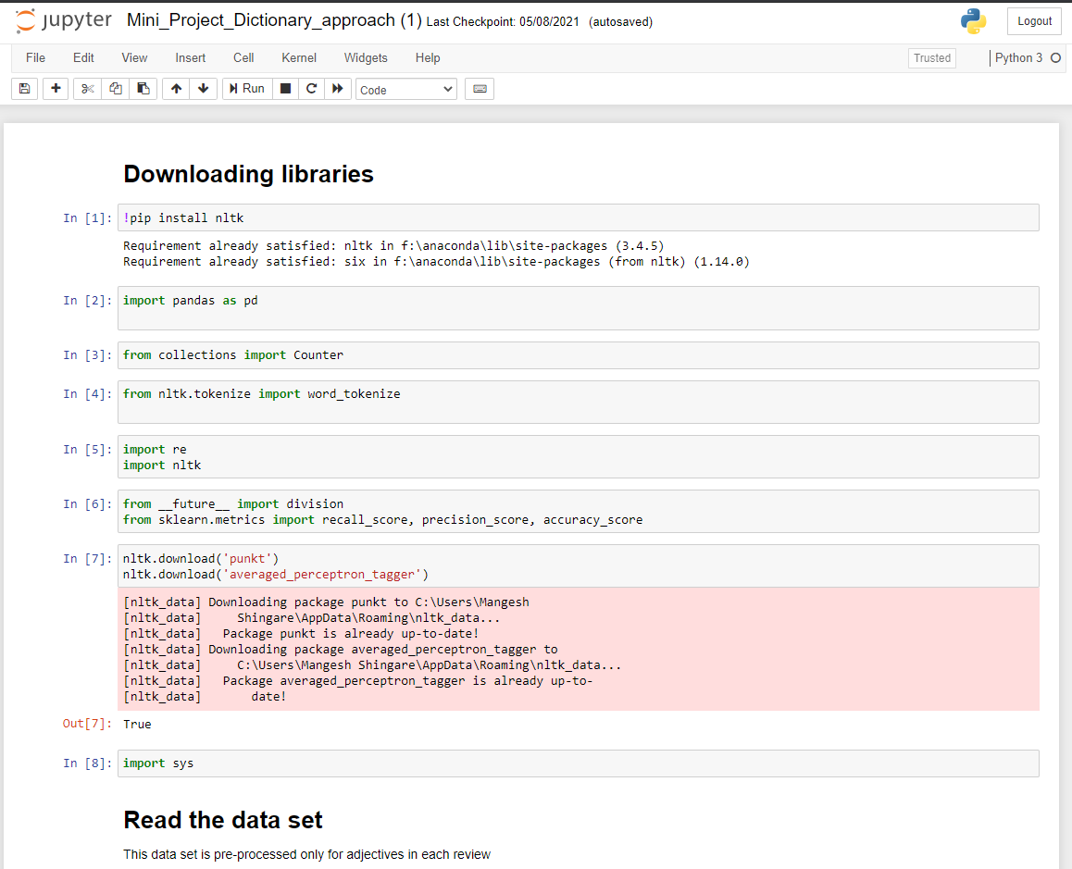
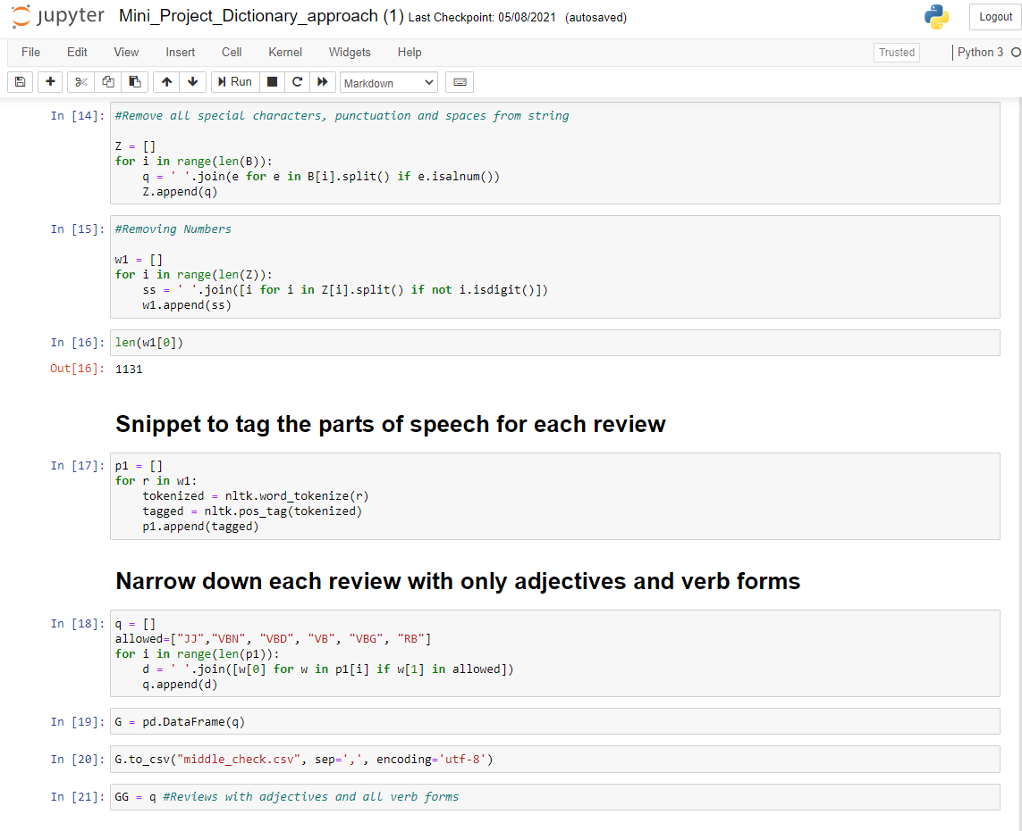
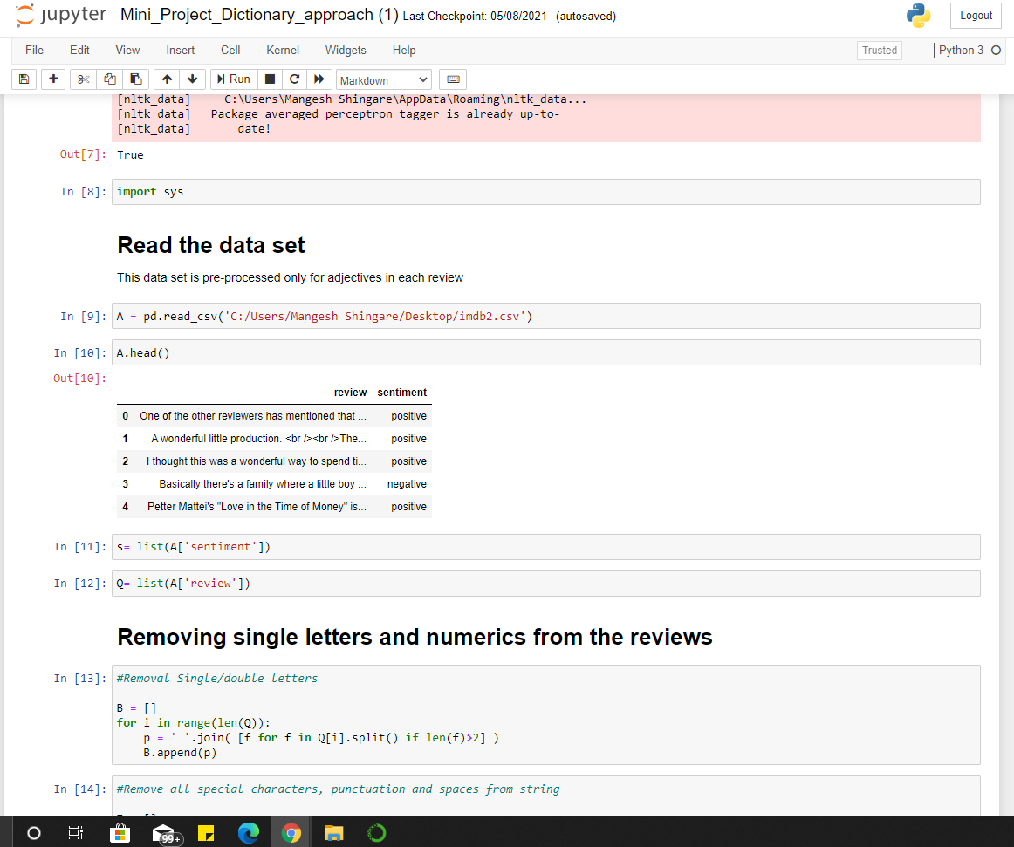
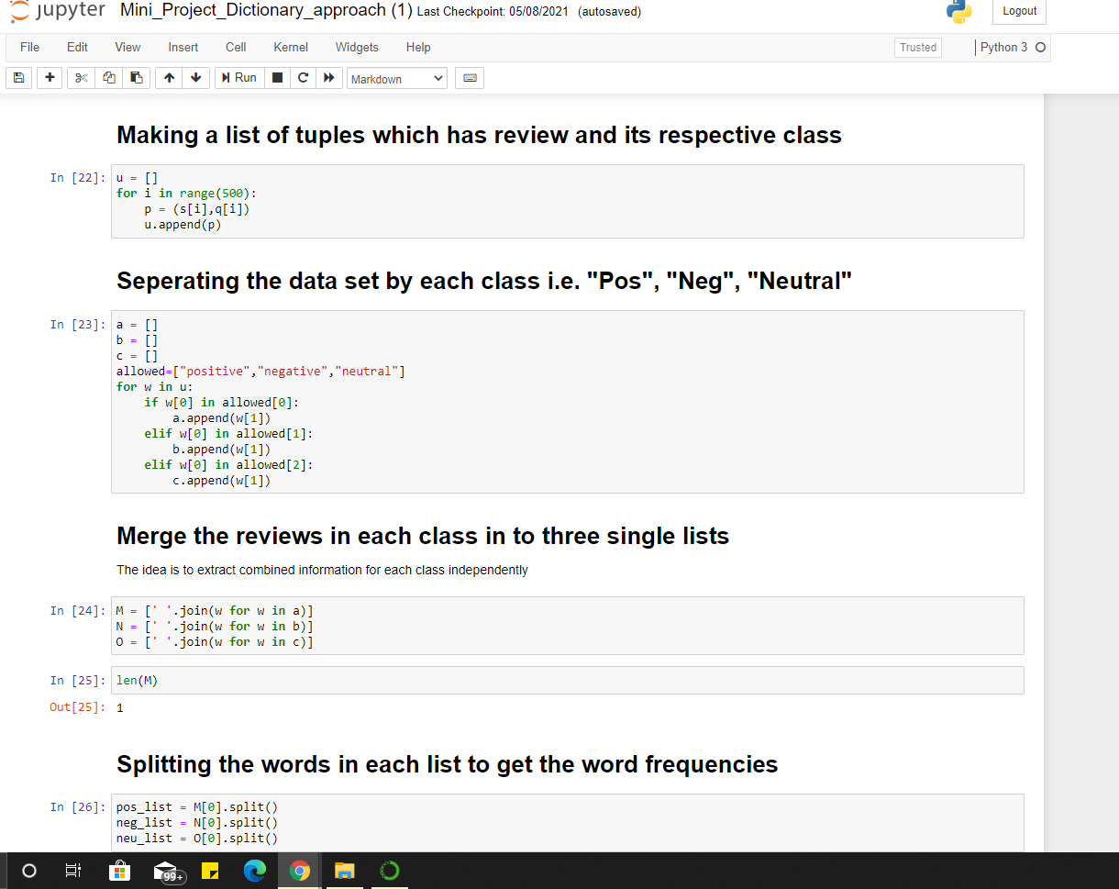
Implementation

Slide 14
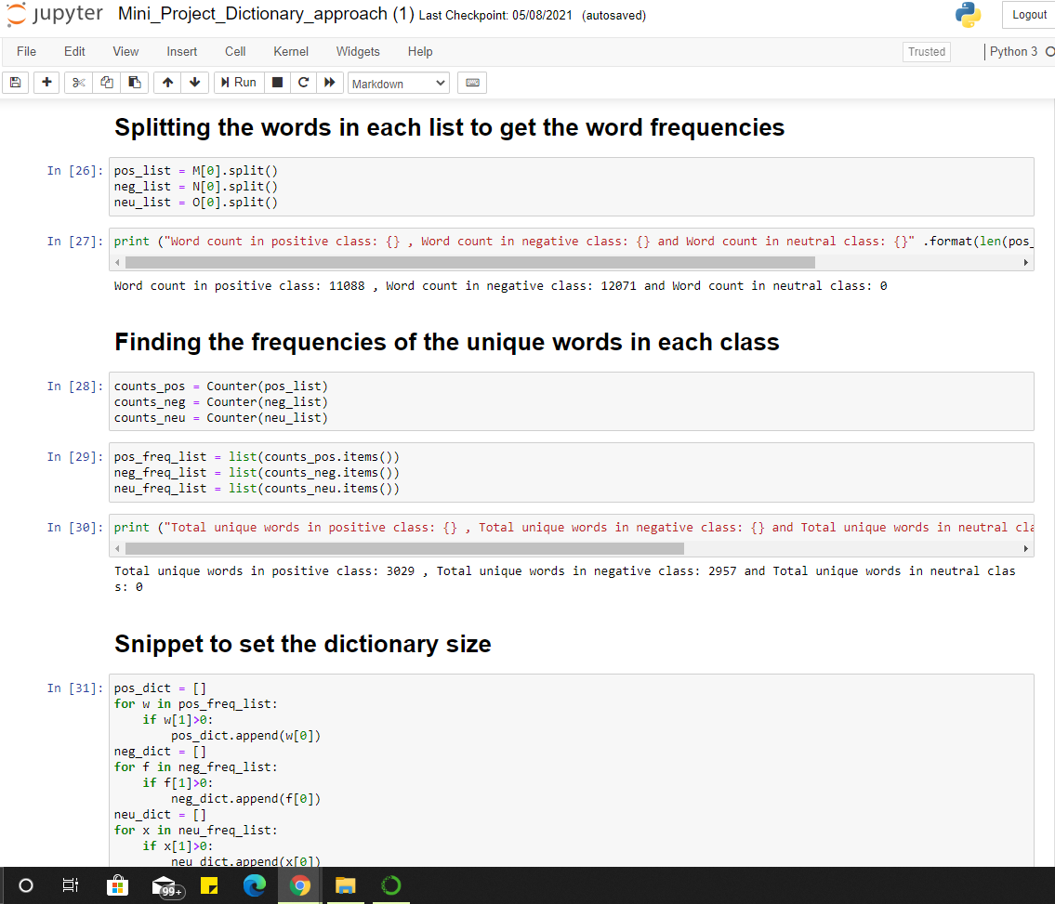
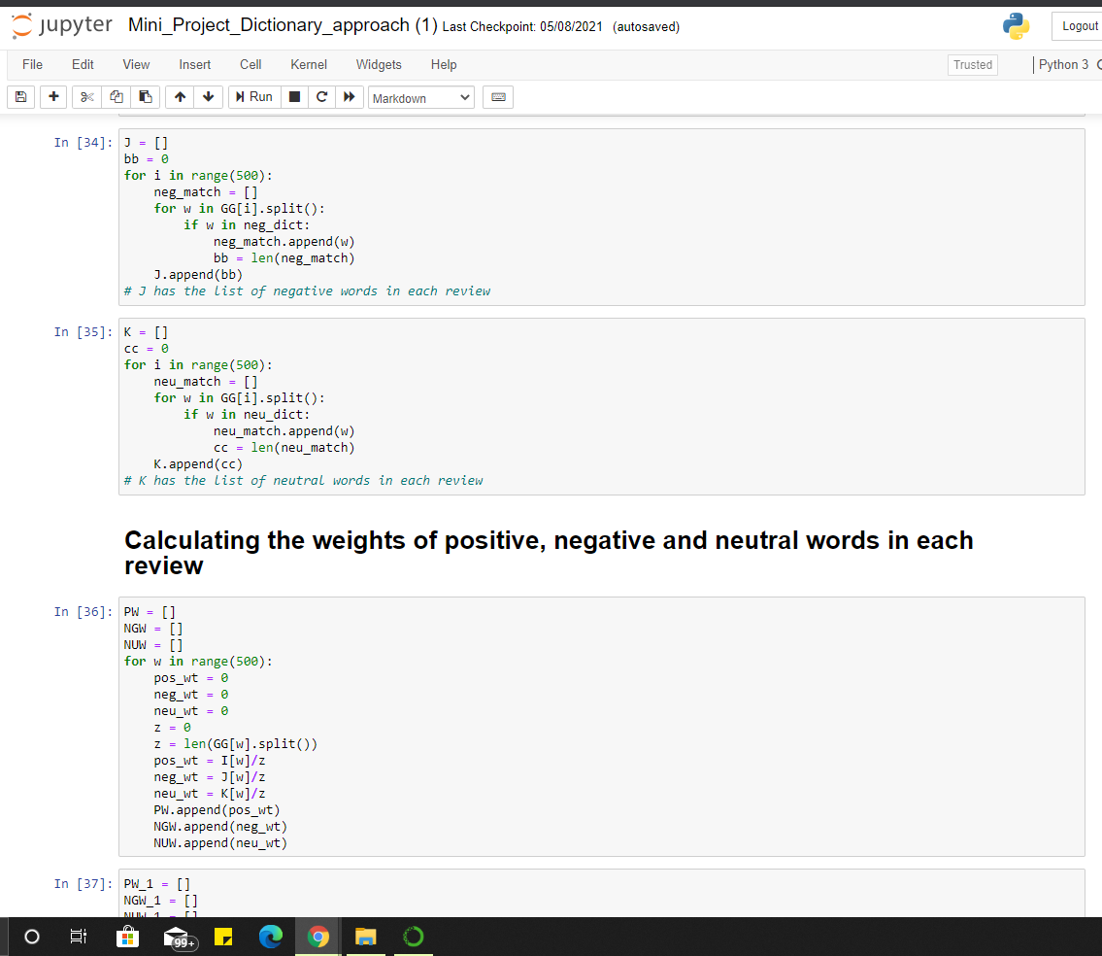
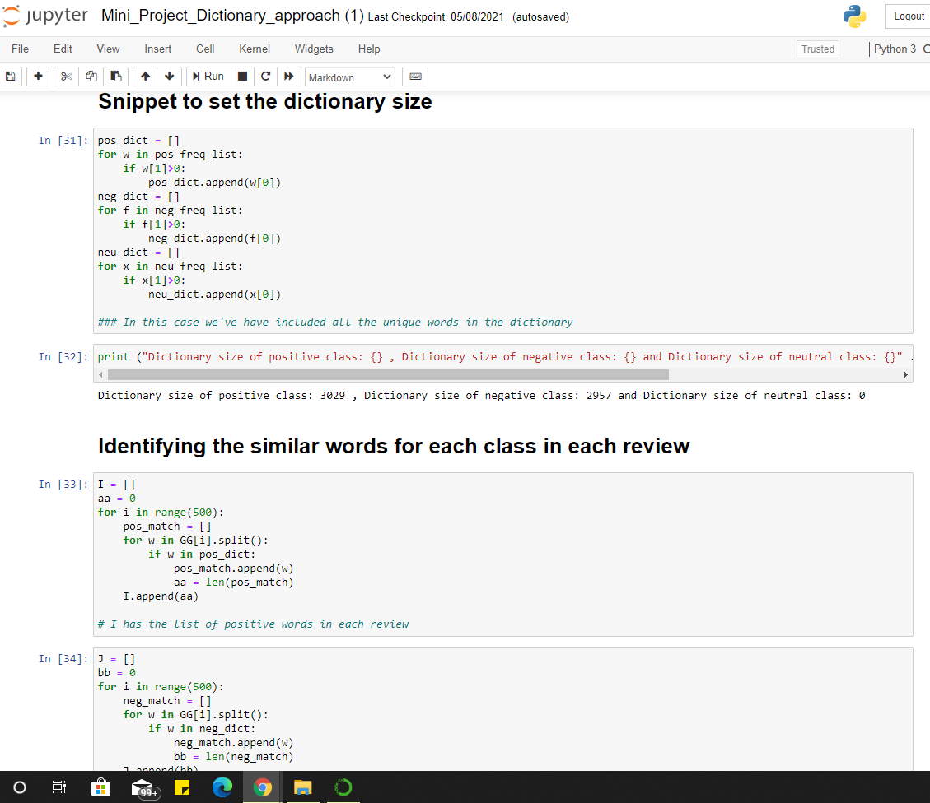
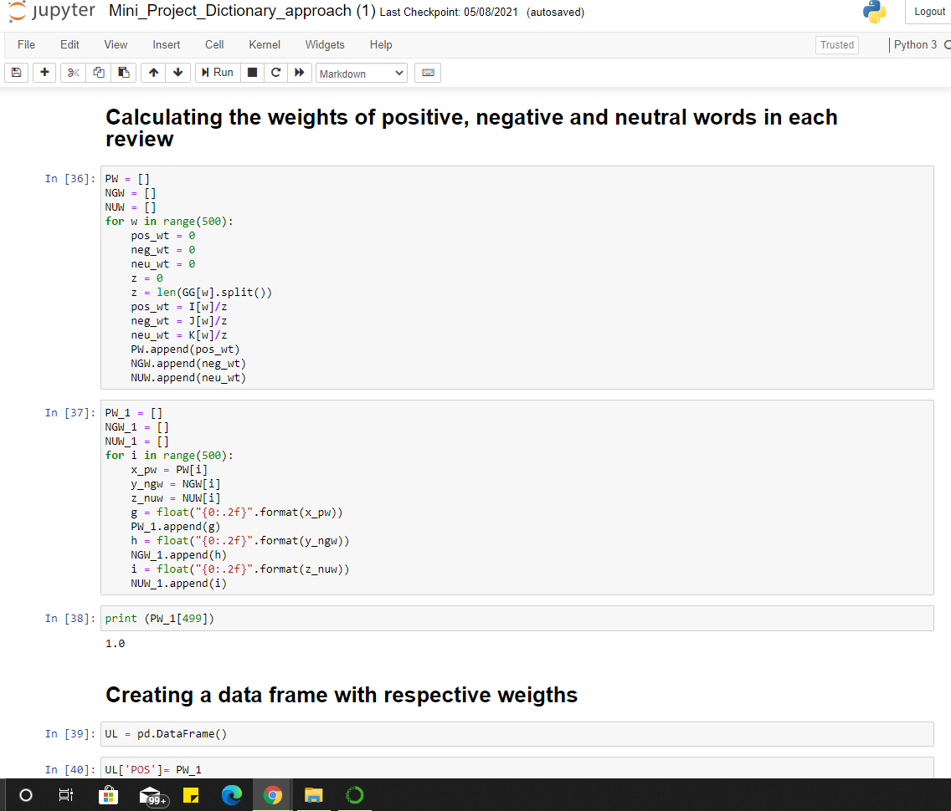
Implementation

Slide 15
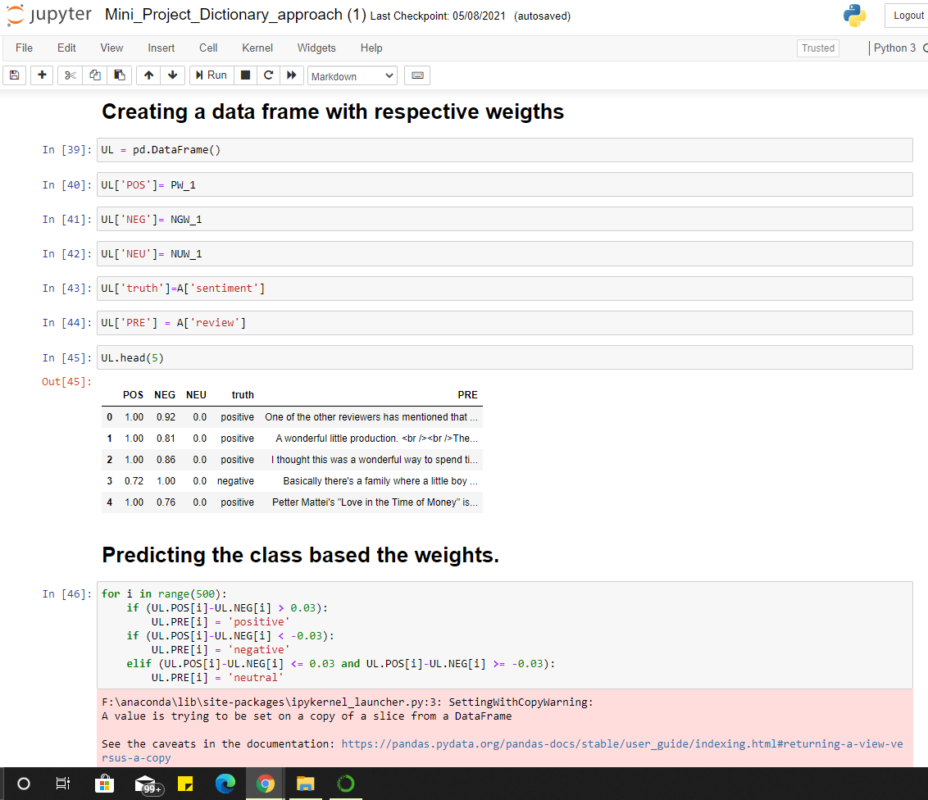
Implementation

Slide 16
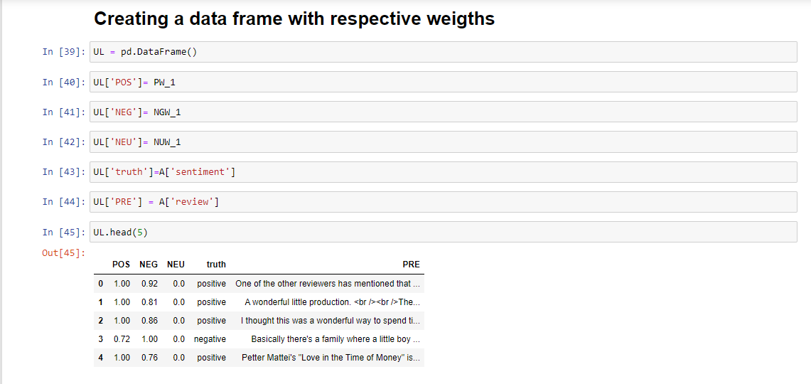
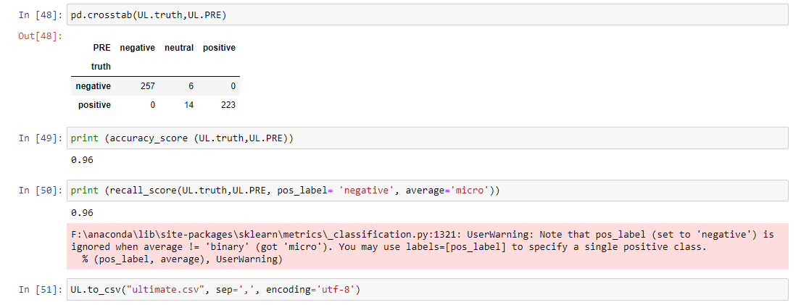
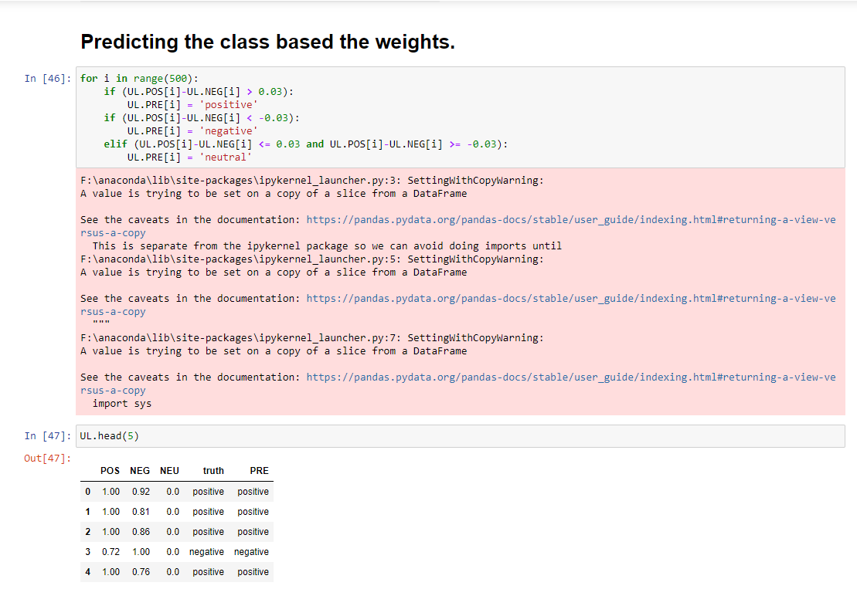
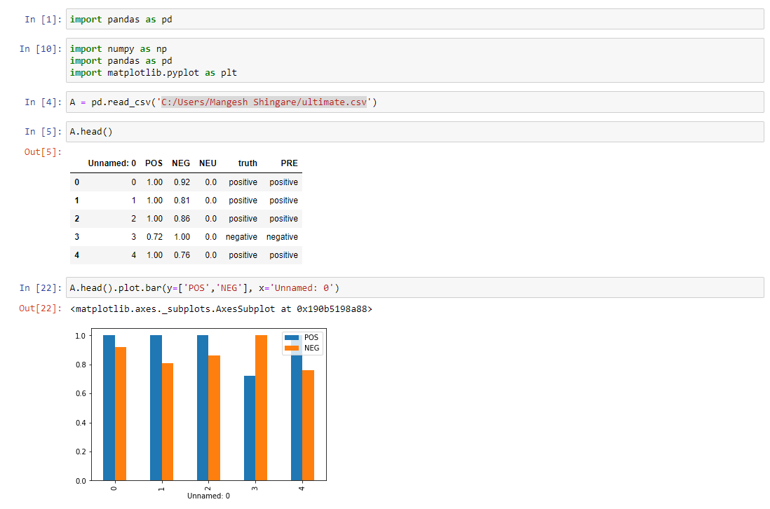
Result/Output

Slide 17
References
1] Walaa Medhat , Ahmed Hassan , Hoda Korashy “Sentiment analysis algorithms and applications: A survey ” School of Electronic Engineering, Canadian International College, Cairo Campus of CBU, Egypt b Ain Shams University, Faculty of Engineering, Computers & Systems Department, Egypt Issued: 19 | April 2014
2] Maite Taboada, Julian Brooke, Milan Tofiloski, Kimberly Vol, Manfred Stede “ LexiconBased Methods for Sentiment Analysis ” Department of Computer Science, University of British Columbia, 201-2366 Main Mall, Vancouver, B.C. V6T 1Z4 Canada. Issue: 28 | September 2010.
3] Karthik Konar , Riddhi Patel “ A Systematic Study on Sentimental Analysis and its Applications ” MCA Student, Dept. of Computer Engineering, NMIMS Mukesh Patel School of Technology Management & Engineering, Vile Parle(West) Mumbai Issue: 06 | June 2020
4] Apoorv Agarwal, Boyi Xie, Ilia Vovsha, Owen Rambow, Rebecca Passonneau Department of Computer Science Columbia University New York, NY 10027 USA Issued: 23 | June 2011
5] Fazal Masud Kundi, Aurangzeb Khan, Shakeel Ahmad, Muhammad Zubair Asghar “Lexicon-Based4 Sentiment Analysis in the Social Web ” Institute of Computing and Information Technology, Gomal University, D.I.Khan, Pakistan, Institute of Engineering and Computer Sciences, University of Science and Technology Bannu, Pakistan Issued: 26 | May 2014

Slide 18
6] Sentiment Analysis: Types, Tools, and Use Cases (https://www.altexsoft.com/blog/business/sentiment-analysis-types-tools-and-use-cases/ )
7] Dhiraj Murthy, Twitter and elections: are tweets, predictive, reactive, or a form of buzz?, Information, Communication & Society, 18:7, 816-831, DOI:10.1080/1369118X.2015.1006659
8] Humera Shaziya, G.Kavitha, Raniah Zaheer, 2015, Text Categorization of Movie Reviews for Sentiment Analysis , International Journal of Innovative Research in Science, Engineering and Technology, Vol. 4, Issue 11.
9] Akshay Amolik, Niketan Jivane, Mahavir Bhandari, Dr .M. Venkatesan, Twitter Sentiment Analysis of Movie Reviews using Machine Learning Techniques, School of Computer Science and Engineering, VIT University, Vellore.
10] Palak Baid,Apoorva Gupta ,Neelam Chaplot , Sentiment Analysis of Movie Reviews using Machine Learning Techniques, International Journal of Computer Applications (0975 – 8887) Volume 179 – No.7, December 2017 45

Slide 19
Thank You!!
Any questions

